Slide 1
Chapter 3
Software Quality Factors

Slide 2
Chapter Three
Software Quality Factors
The need for comprehensive Software Quality Requirements
Classification of requirements into Software Quality Factors
Product Operation Factors
Product Revision Factors
Product Transition Factors
Alternative models of software quality factors
Who is interested in defining quality requirements?
Software compliance with Quality Factors

Slide 3
The Requirements Document
Requirement Documentation (Specification) is one of the most important elements for achieving software quality
Need to explore what constitutes a good software requirements document.
Some SQA Models suggest 11-15 factors categorized; some fewer; some more
Want to become familiar with these quality factors, and
Who is really interested in them.
The need for comprehensive software quality requirements is pervasive in numerous case studies (see a few in this chapter).
(Where do the quality factors go??)

Slide 4
Need for Comprehensive Software Quality Requirements
Need for improving poor requirements documents is widespread
Frequently lack quality factors such as: usability, reusability, maintainability, …
Software industry groups the long list of related attributes into what we call quality factors. (Sometimes non-functional requirements)
Natural to assume an unequal emphasis on all quality factors.
Emphasis varies from project to project
  Scalability; maintainability; reliability; portability; etc.
Let’s look at some of the categories…

Slide 5
Extra Thoughts
Seems like in Software Engineering we concentrate on capturing, designing, implementing, and deploying with emphasis on functional requirements.
Little (not none!) emphasis on the non-functional requirements (quality factors).
More and more emphasis now placed on quality factors
Can be a critical factor in satisfying overall requirements.
In the RUP, non-functional requirements are captured in the Software Requirements Specification (SRS); functional requirement usually captured in Use Case stories.

Slide 6
McCall’s Quality Factors
McCall has 11 factors; Groups them into categories.
  1977; others have added, but this still prevail.
Three categories:
  Product Operation Factors
    How well it runs….
    Correctness, reliability, efficiency, integrity, and usability
  Product Revision Factors
    How well it can be changed, tested, and redeployed.
    Maintainability; flexibility; testability
  Product Transition Factors
    How well it can be moved to different platforms and interface with other systems
    Portability; Reusability; Interoperability
Since these underpin the notion of quality factors and others who have added, reword or add one or two, we will spend time on these factors.

Slide 7
McCall's software quality
factors model
Software quality factors
Product operation factors
Product revision factors
Product transition factors

Slide 8
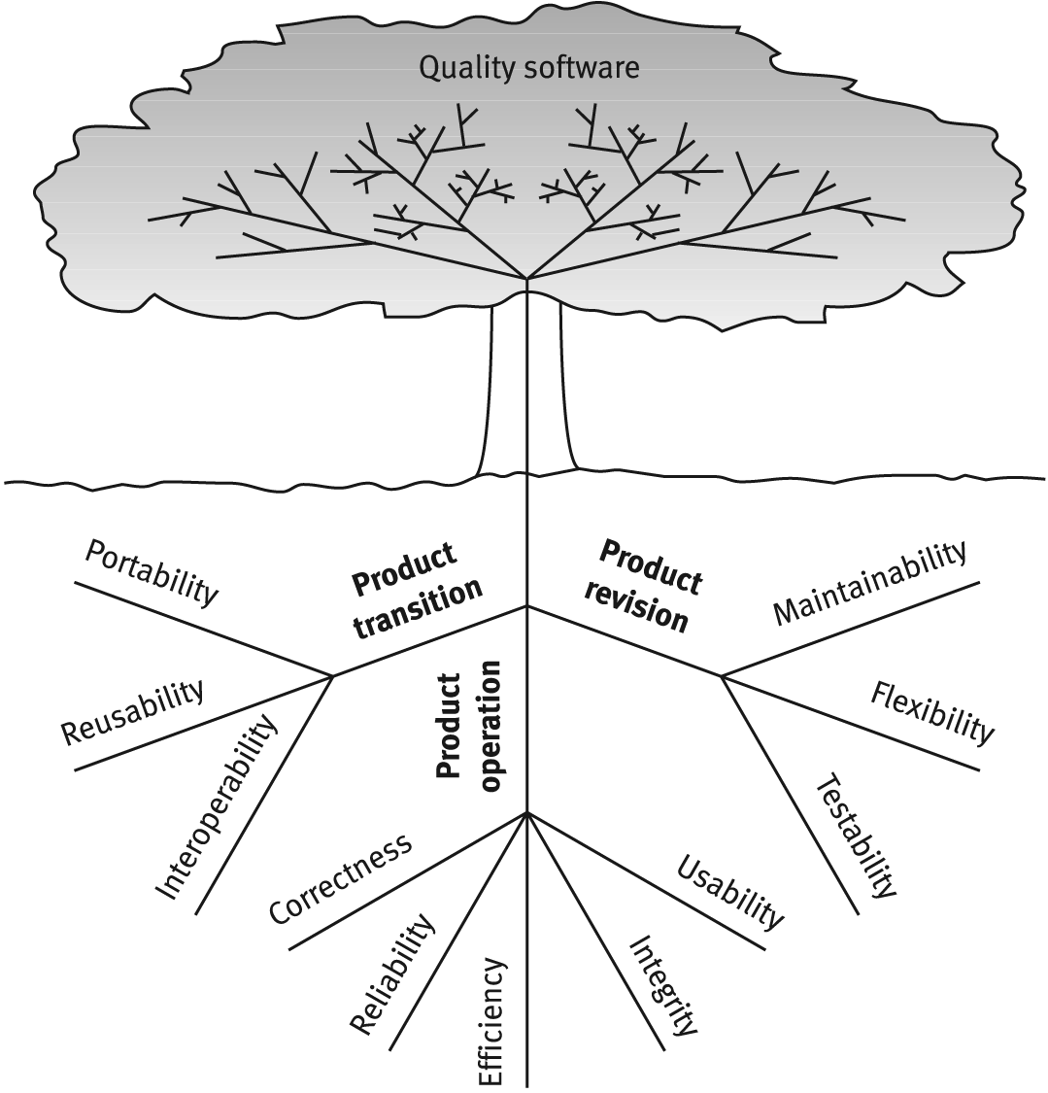
McCalls factor model tree

Slide 9
Product operation factors
Correctness
Reliability
Efficiency
Integrity
Usability
How well does it run and ease of use.

Slide 10
McCall’s Quality Factors
Category: Product Operation Factors
1. Correctness.
Please note that we are asserting that ‘correctness’ issues are arising from the requirements documentation and the specification of the outputs…
Examples include:
  Specifying accuracies for correct outputs at, say, NLT <1% errors, that could be affected by inaccurate data or faulty calculations;
  Specifying the completeness of the outputs provided, which can be impacted by incomplete data (often done)
  Specifying the timeliness of the output (time between event and its consideration by the software system)
  Specifying the standards for coding and documenting the software system
  we have talked about this: standards and integration; Essential!!

Slide 11
McCall’s Quality Factors
Category: Product Operation Factors
2. Reliability Requirements. (remember, this quality factor is specified in the specs!)
Reliability requirements deal with the failure to provide service.
  Address failure rates either overall or to required functions.
Example specs:
  A heart monitoring system must have a failure rate of less than one per million cases.
  Downtime for a system will not be more than ten minutes per month (me)
  MTBF and MTTR - old and engineering, but still applicable.
3. Efficiency Requirements. Deals with the hardware resources needed to perform the functions of the software.
  Here we consider MIPS, MHz (cycles per second); data storage capabilities measured in MB or TB; communication lines (usually measured in KBPS, MBPS, or GBPS).
  Example spec: simply very slow communications…

Slide 12
McCall’s Quality Factors
Category: Product Operation Factors
4. Integrity – deal with system security that prevent unauthorized persons access.
Huge nowadays; Cyber Security; Internet security; network security, and more. These are certainly not the same!
5. Usability Requirements – deals with the scope of staff resources needed to train new employees and to operate the software system.
  Deals with learnability, utility, usability, and more. (me)
  Example spec: A staff member should be able to process n transactions / unit time. (me)

Slide 13
Product revision factors
Maintainability
Flexibility
Testability
Can I fix it easily, retest, version it, and deploy it easily?

Slide 14
McCall’s Quality Factors
Category: Product Revision Software Factors
These deal with requirements that affect the complete range of software maintenance activities:
  corrective maintenance,
  adaptive maintenance, and
  perfective maintenance
  KNOW THE DIFFERENCES!
1. Maintainability Requirements
  The degree of effort needed to identify reasons (find the problem) for software failure and to correct failures and to verify the success of the corrections.
  Deals with the modular structure of the software, internal program documentation, programmer manual, architectural and detail design and corresponding documentation
  Example specs: size of module <= 30 statements.
  Refactoring...

Slide 15
McCall’s Quality Factors
Category: Product Revision Software Factors
2. Flexibility Requirements – deals with resources to change (adopt) software to different types of customers that use the app perhaps a little differently;
  May also involve a little perfective maintenance to perhaps do a little better due to the customer’s perhaps slightly more robust environment.
  Different clients exercise software differently. This is big!
3. Testability Requirements –
  Are intermediate results of computations predefined to assist testing?
  Are log files created? Backup?
  Does the software diagnose itself prior to and perhaps during operations?

Slide 16
Product transition factors
Portability
Reusability
Interoperability
Can I move the app to different hardware?
Interface easily with different hardware / software systems; can I reuse major portions of the code
with little modification to develop new apps?

Slide 17
McCall’s Quality Factors
Category: Product Transition Software Quality Factors
1. Portability Requirements: If the software must be ported to different environments (different hardware, operating systems, …) and still maintain an existing environment, then portability is a must.
2. Reusability Requirements: Are we able to reuse parts of the app for new applications?
  Can save immense development costs due to errors found / tested.
  Certainly higher quality software and development more quickly results.
  Very big deal nowadays.

Slide 18
McCall’s Quality Factors
Category: Product Transition Software Quality Factors
3. Interoperability Requirements: Does the application need to interface with other existing systems
  Frequently these will be known ahead of time and plans can be made to provide for this requirement during design time.
    Sometimes these systems can be quite different; different platforms, different databases, and more
  Also, industry or standard application structures in areas can be specified as requirements.

Slide 19
Alternatives
Some other SQA professionals have offered essentially renamed quality factors.
One has offered 12 factors; another 15 factors.
Totally five new factors were suggested
Evans and Marciniak offer two ‘new’ ones:
  Verifiability and Expandability
Deutsch and Willis offer three ‘new’ ones.
  Safety
  Manageability, and
  Survivability

Slide 20
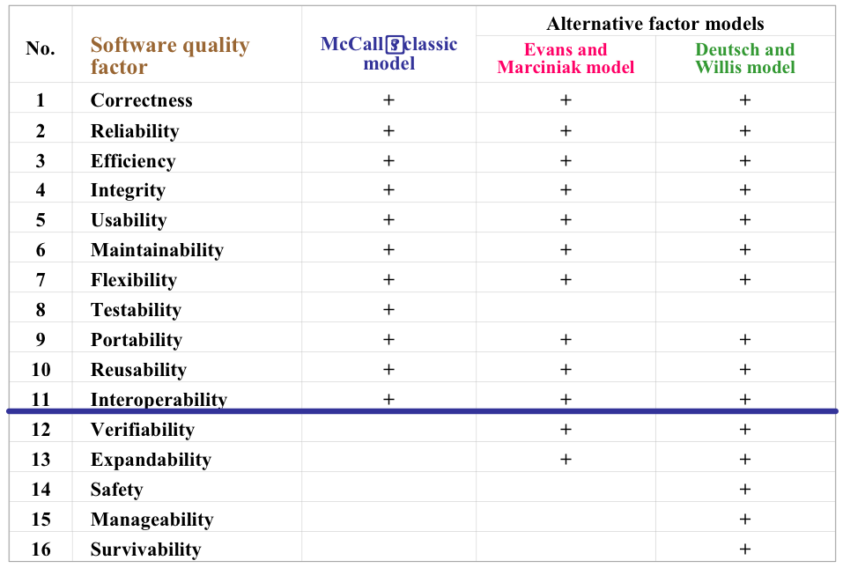
McCall's factor model
and alternative models

Slide 21
Alternatives
Evans and Marciniak offer Verifiability and Expandability
  1. Verifiability Requirements addresses design and programming features that allow for efficient verification of design and programming;
    This does not refer to outputs; rather, structure of code; design elements and their dependencies, coupling, cohesion; patterns…
  apply to modularity, simplicity, adherence to documentation and programming guidelines, etc.
  Look at the UML for dependencies, cohesion, coupling…
  2. Expandability Requirements really refers to scalability and extensibility to provide more usability.
    Essentially this is McCall’s flexibility

Slide 22
Alternatives
Deutsch and Willis offer Safety, Manageability, and Survivability
  1. Safety Requirements address conditions that could bring the equipment or application down especially for controlling software, as in setting alarms or sounding warnings.
    Especially important to process control / real time software such as that running conveyor belts or instrumentation for ordinance…
  2. Manageability Requirements refer to tools primarily administrative to control versions, configurations and change management / tracking.
    We must have tools to manage versions and various configurations that may vary from customer to customer.
  3. Survivability Requirements refer to MTBF, or continuity of service, as well as MTTR (mean time to recover).
    Appears to be quite similar to Reliability in McCall’s model

Slide 23
Comparisons
These all are pretty close.
Both models do add Verifiability,
I like this one; addresses design and programming. (programming conventions / standards, etc.)
  As we have developed as a discipline, I think this is essential.
Safety is clearly important as computers control more and more of what we do especially in both hardware and in software.
  New cars will now sound an alarm as we back up; software will sound when power is interrupted. This is important.

Slide 24
So, Who Cares?
Both developers and clients need to care. One group may care more than the other for certain quality factors.
Certainly the nature of the app dictates more concern on some of these factors than others (safety, for example)
In the Rational Unified Process, we call this component of the requirements the SRS (software requirement specifications, which contains these ‘non-functional requirements’ which are requirements in every sense of the word – just not functional requirements, as the term is normally used.
What are your feelings about these quality factors?

Slide 25
Homework #3
You may work alone or with one student on this assignment:
1. Please address each of the McCall’s quality factors and address how each apply to software and/or hardware (not using the examples in the chapter). Please add verifiability and safety.
  Develop a short paper in Word that has no less than a single paragraph addressing each of these quality factors. (This may take a two pages)
  Table 3.3 may provide some assistance.
2. Answer question 3.2
Due: Next Wednesday no later than (NLT) 4pm via Blackboard.

Slide 26
Team Discussion
Team 3 is to lead the discussion on the following questions:
You must summarize the main points in the chapter, and lead discussions on:
3.3
3.4
3.5

